Slide 1
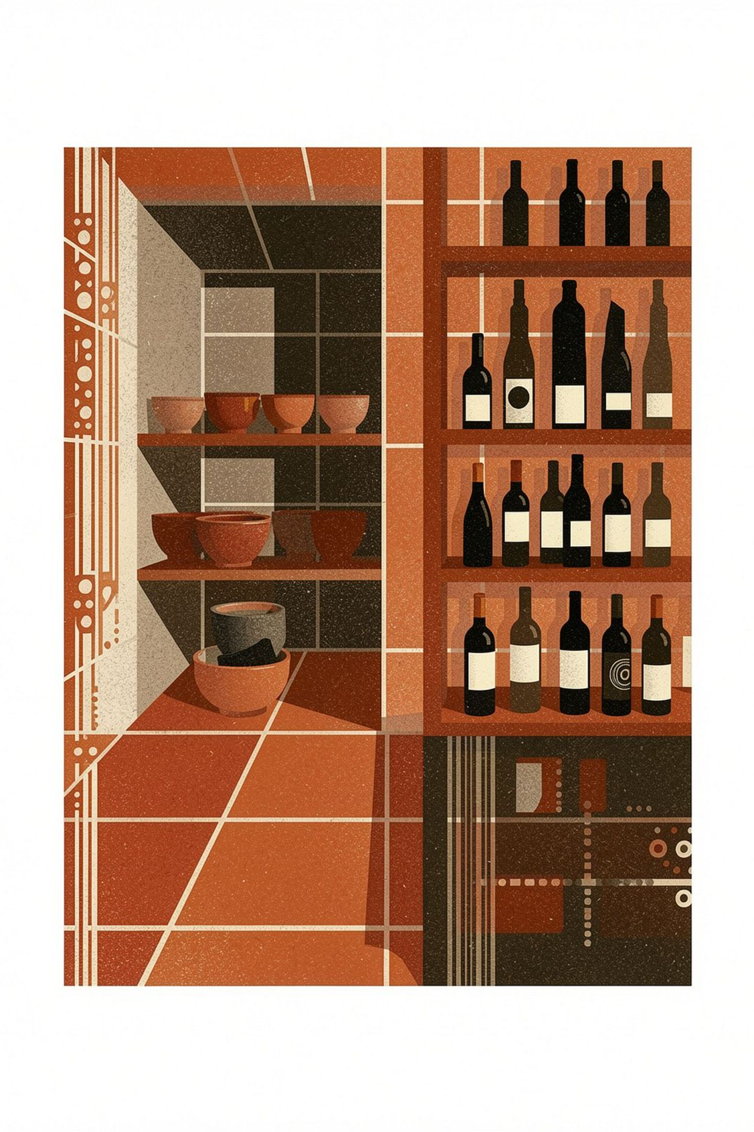

Quinta da Ribeira Q2 2026 Results
Two-person review · 120 orders · €3,395.50 in revenue · Q3 priorities ahead
Welcome the team. Today we're reviewing our Q2 performance—120 orders, €3,395.50 in revenue, and two data issues we've resolved. We'll also outline three priorities for Q3.

Slide 2
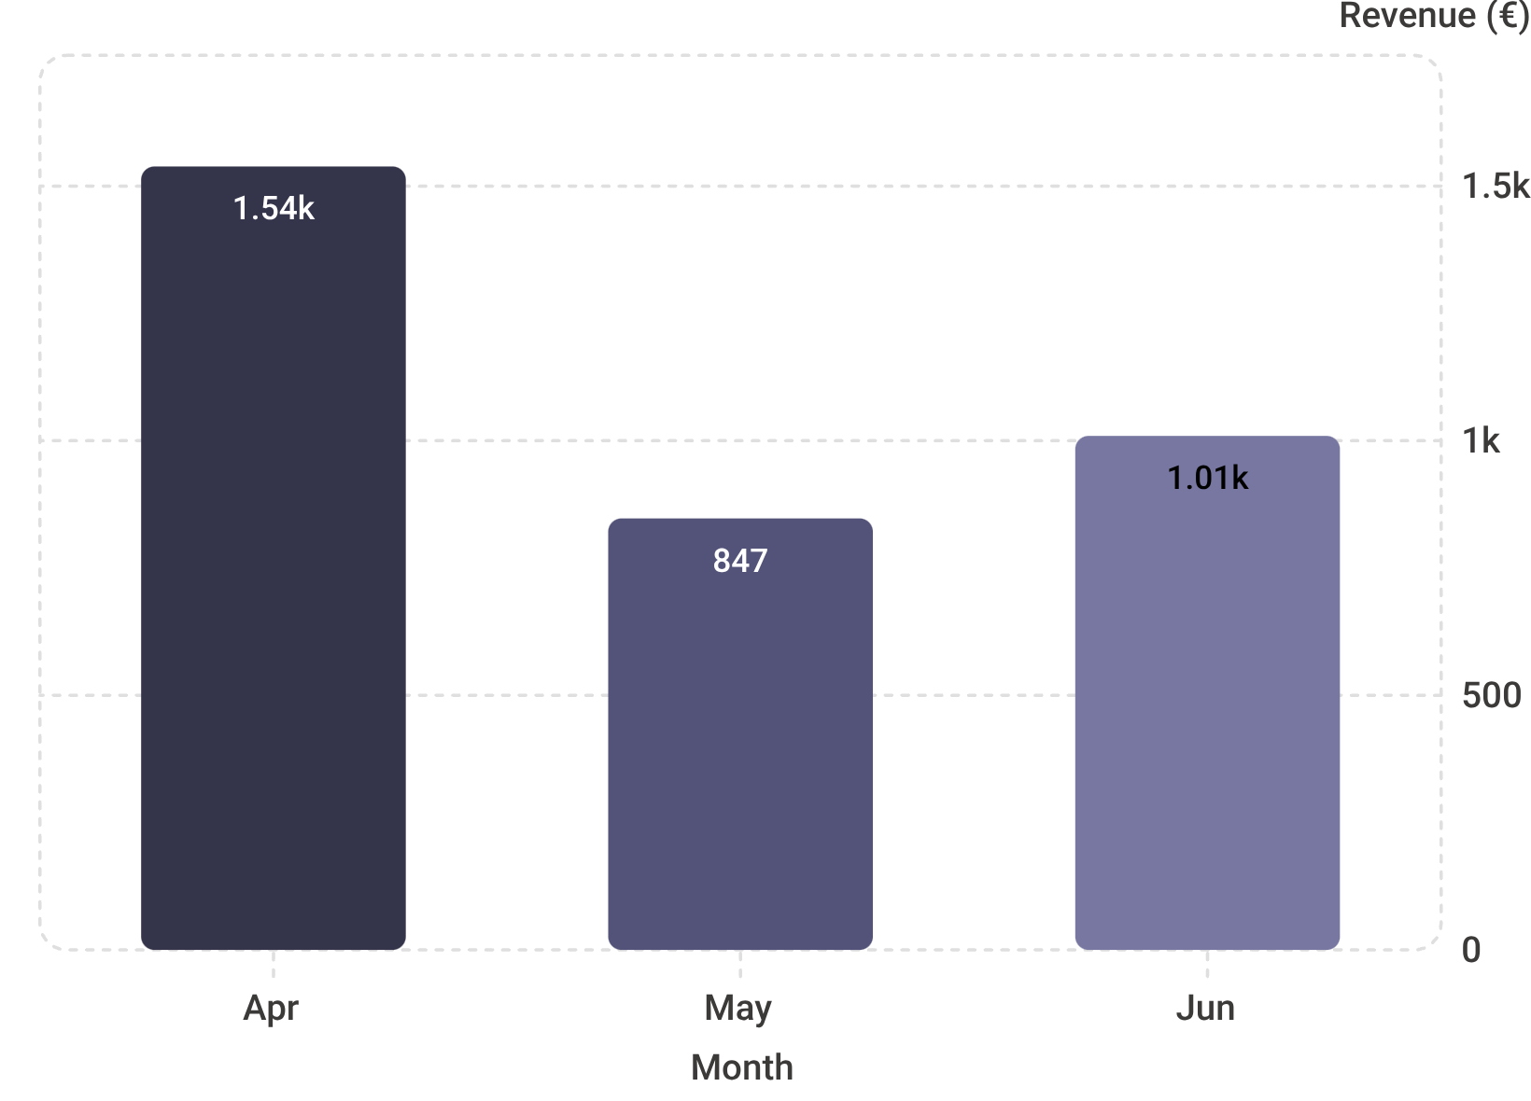
Revenue by Month: April Led, June Recovered
Q2 Monthly Breakdown
April: €1,538.60 — strongest month
May: €847.40 — notable dip
June: €1,009.50 — clear recovery
Q2 Total: €3,395.50
Monthly average: €1,131.83
April was our strongest month. May dipped, but June showed recovery. The quarter averaged €1,131.83 per month.

Slide 3
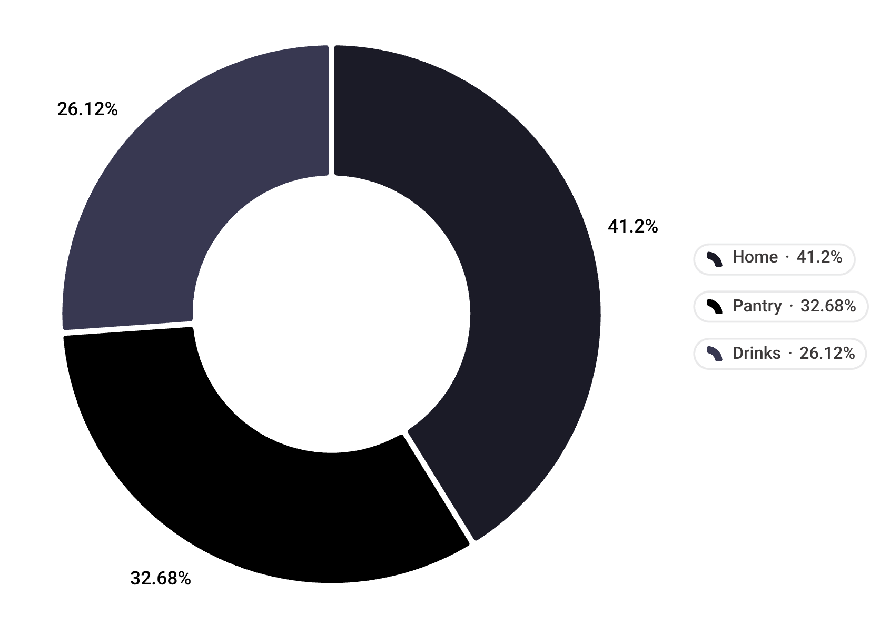


Revenue by Category: Home Leads
Category Performance
Home — 41%
€1,399.00 · Strongest category
Pantry — 33%
€1,109.70 · Solid performer
Drinks — 26%
€886.80 · Room to grow in Q3
Home products are our strongest category. Pantry and Drinks are solid but have room to grow. Consider how to boost Drinks revenue in Q3.

Slide 4
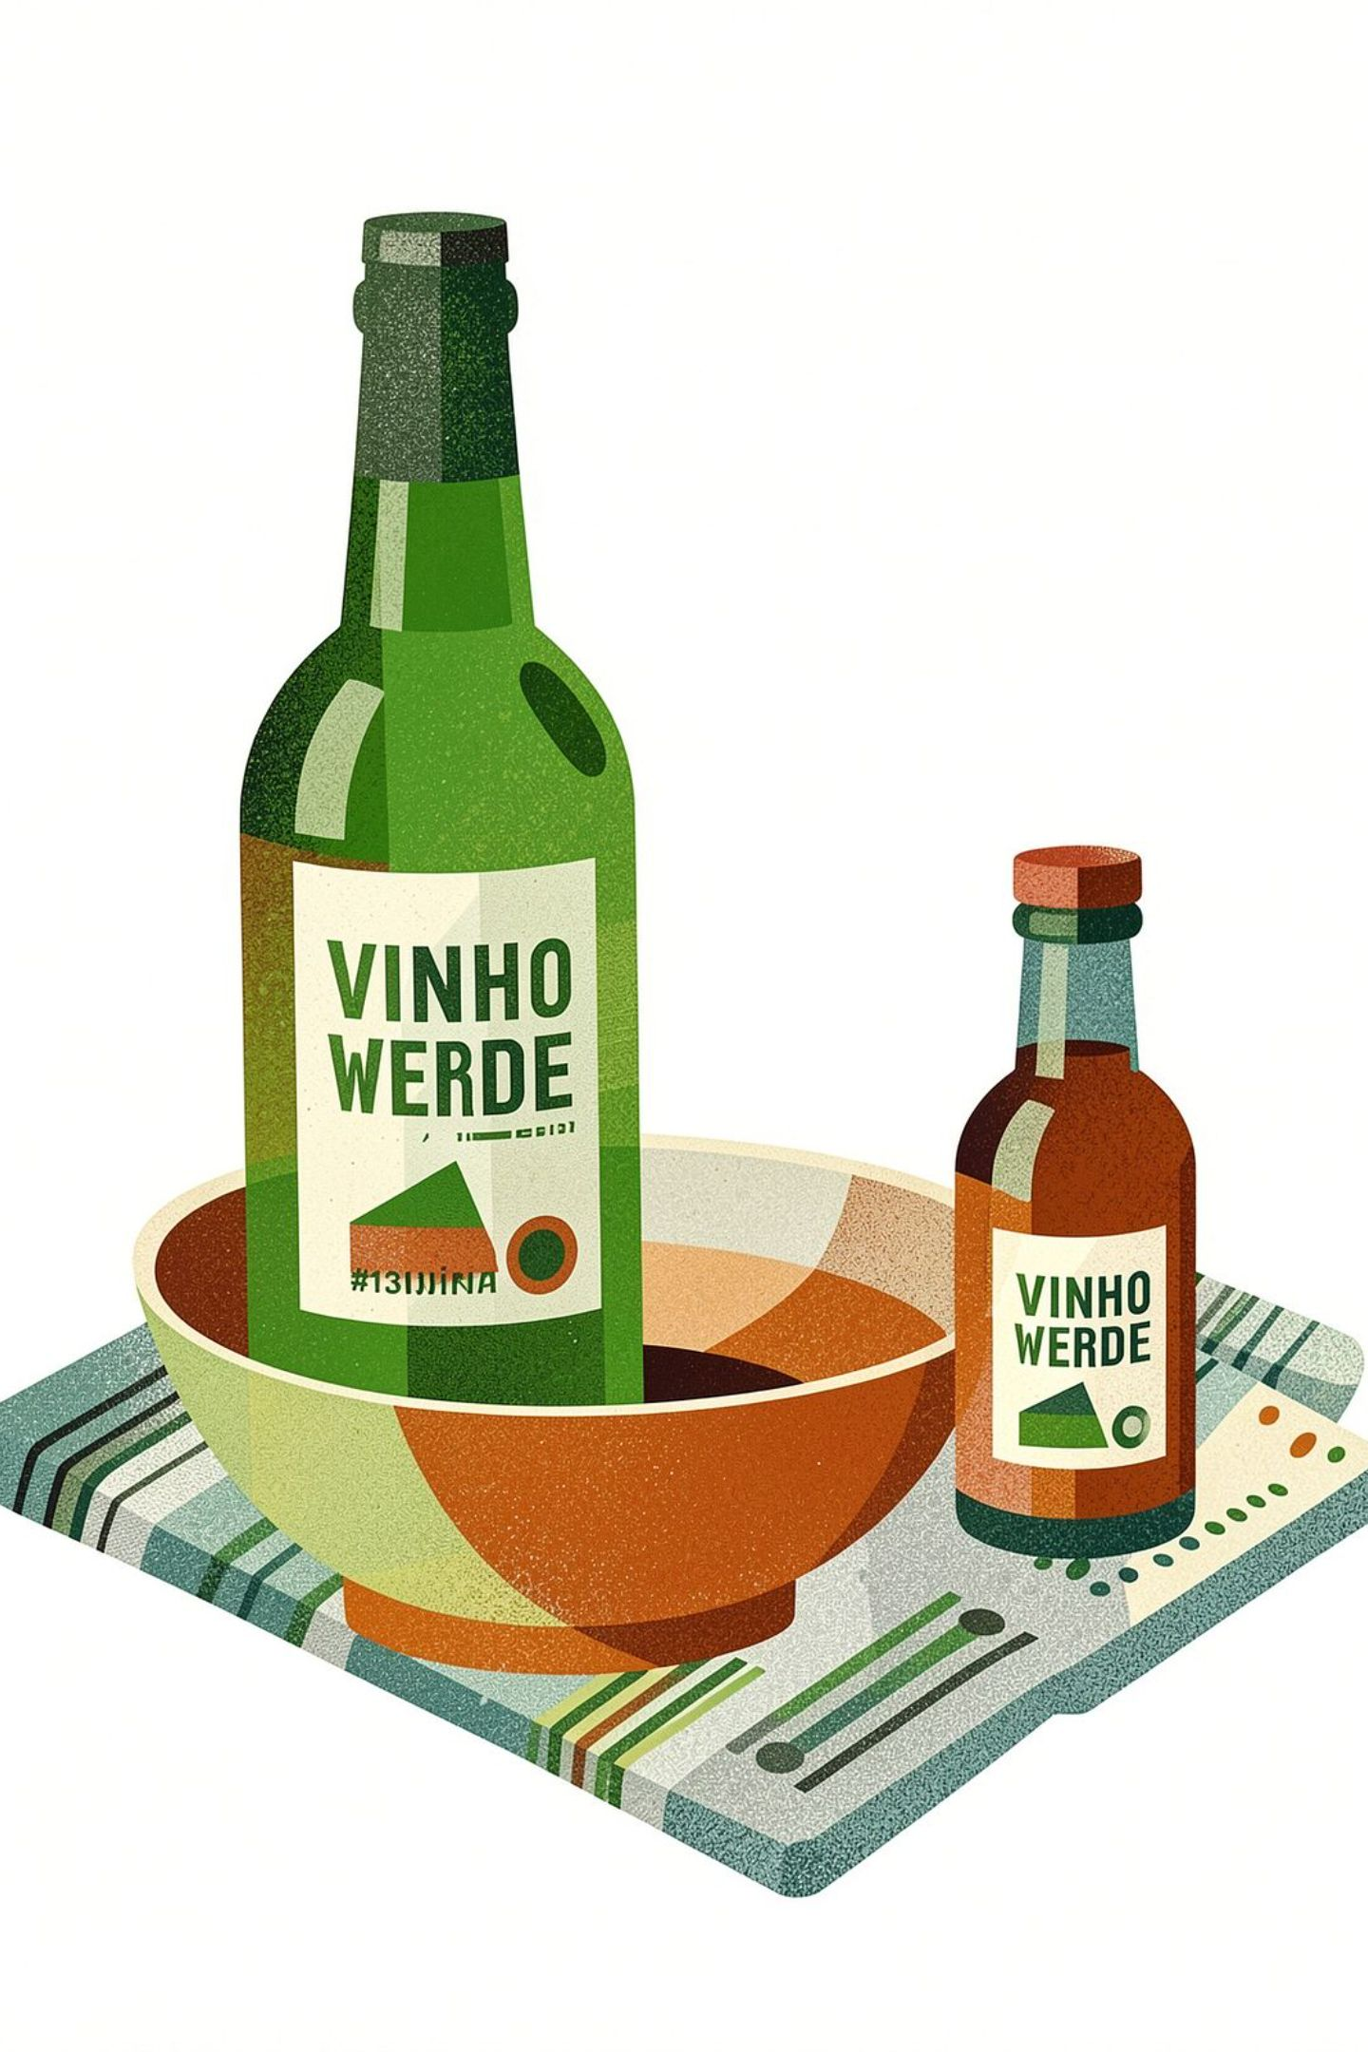

Top Products: Vinho Verde Leads
42
40
Vinho Verde 750ml
Ceramic Bowl
Top-selling product — leading drink
Top Home product — high demand
38
Ginjinha 200ml
Second top drink — strong volume
These three products account for significant volume. Vinho Verde and Ginjinha are our top drinks; Ceramic Bowl is our top Home product. Stock and marketing should focus here.

Slide 5
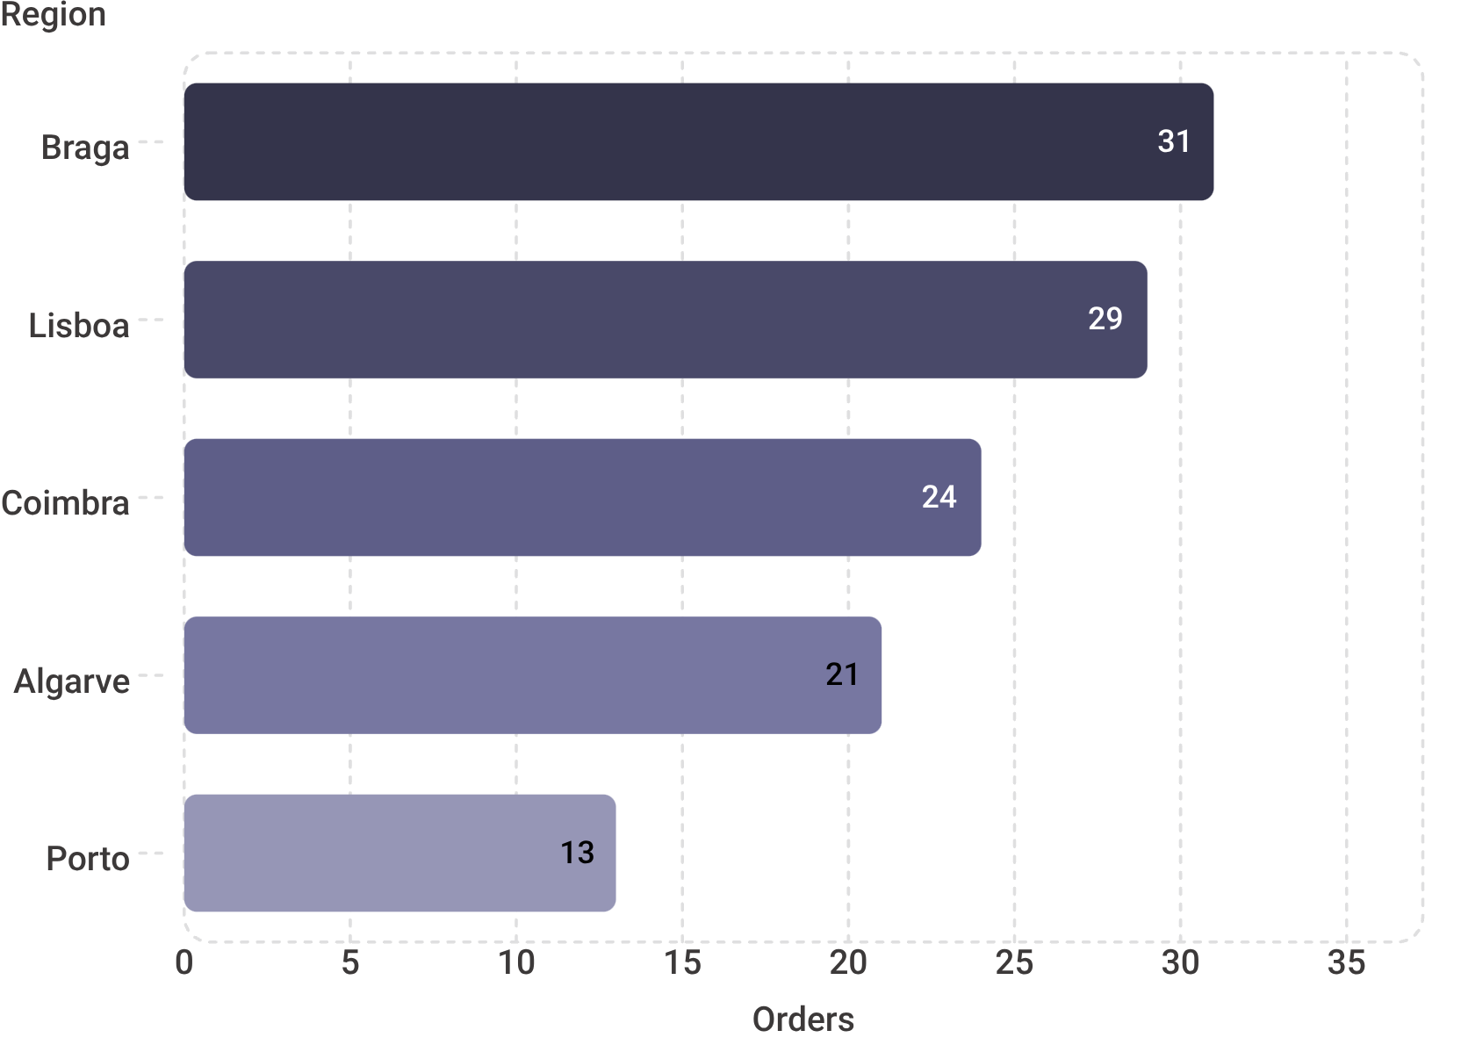
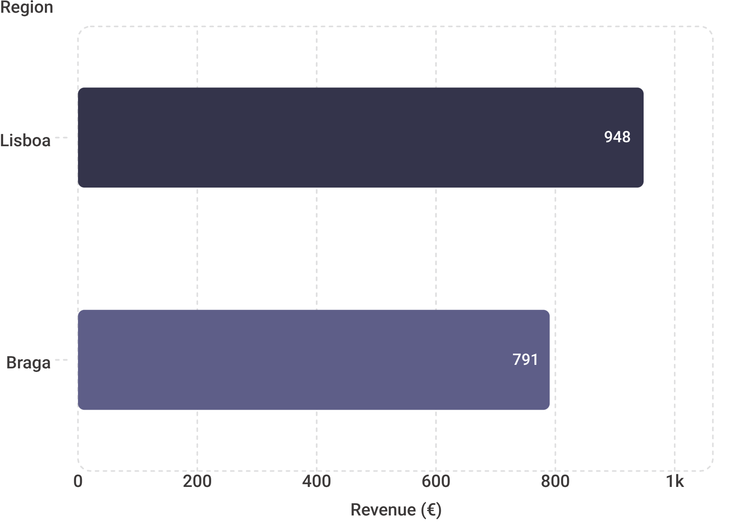

Orders by Region: Braga Leads in Volume, Lisboa in Revenue
Order Count by Region
Revenue by Region
Braga leads in order count, but Lisboa generates higher revenue per order. Porto is our smallest market — opportunity ahead.
Braga has the most orders but Lisboa generates higher revenue per order. Porto is our smallest market — opportunity for growth. Consider regional marketing strategies.

Slide 6


Data Problems Found and Fixed
Two Issues Identified and Resolved
Duplicate Orders
4 duplicate orders found and removed from the export.
Mismatched Totals
5 orders where total ≠ quantity × price — all corrected.
Both issues have been resolved. Our Q2 figures are reliable.
These fixes improve data reliability going forward and give us full confidence in our Q2 numbers.

Slide 7

Three Actions for Q3
1
2
3
Standardize Date Format
Summer Bundle
Reorder Ceramic Bowls
Fix the date format in the order export to prevent future data inconsistencies.
Create a summer bundle pairing Vinho Verde + Ginjinha — leveraging our two top drinks.
Place the reorder before August to avoid stocking out of our second-best product.
These three actions address data quality, product strategy, and inventory. The bundle leverages our top drinks; the bowl reorder ensures we don't stock out of our second-best product.

Slide 8

Let's Execute Q3
Solid Q2 Results
Clean Data
120 orders · €3,395.50 revenue
Issues found, fixed, and documented
Clear Roadmap
Three focused actions for Q3
We have solid Q2 results, clean data, and a clear roadmap. Let's focus on these three actions and build on our momentum. Questions?

