Slide 1
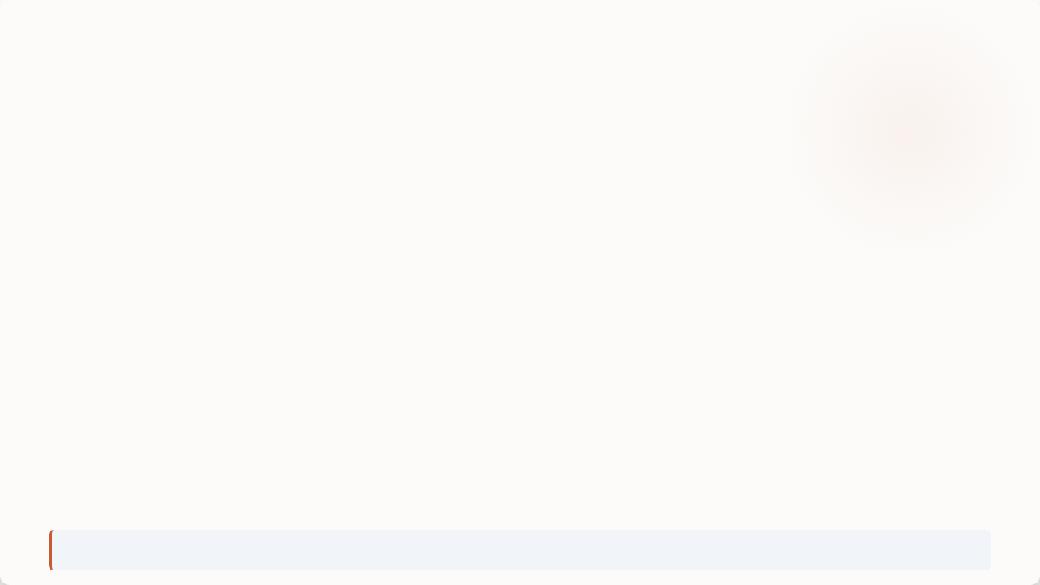

Q2 2026 Results
Quarterly Performance Overview & Q3 Action Plan for Our Two-Person Team
€3,395.50
120
20
€28.30
TOTAL REVENUE
TOTAL ORDERS
UNIQUE CUSTOMERS
AVERAGE ORDER
Speaker Notes: Welcome team. Today we are reviewing our Q2 2026 performance for the Quinta da Ribeira online shop, covering monthly sales, category breakdown, top items, regional figures, data cleanups, and our three action items for Q3.

Slide 2

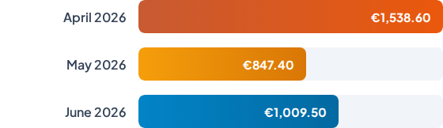
Revenue by Month
Quarter Total: €3,395.50
• April was our highest revenue month at €1,538.60.
• May generated €847.40.
• June brought revenue back up to €1,009.50.
• Overall quarter generated 120 orders with an average order value of €28.30.
Speaker Notes: April was our strongest month bringing in €1,538.60. Revenue dipped in May to €847.40 before rebounding in June to €1,009.50, totaling €3,395.50 across 120 orders for Q2.

Slide 3
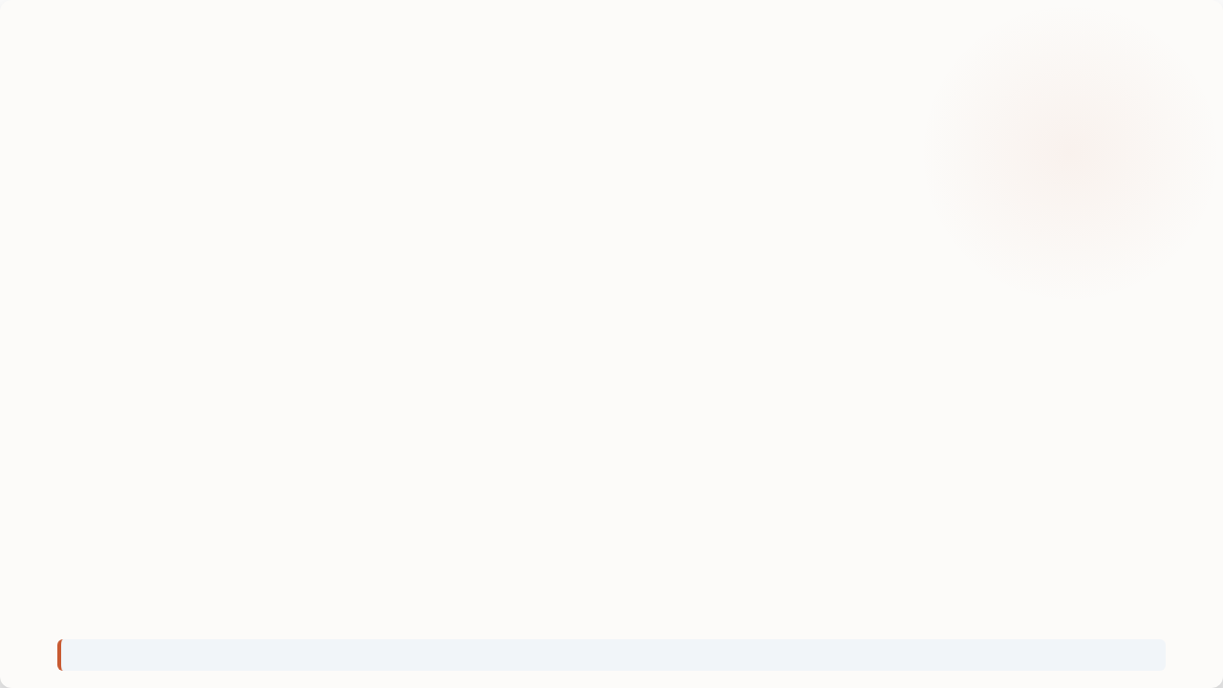






Revenue by Category
Home
Pantry
Drinks
€1,399.00
€1,109.70
€886.80
Leading revenue category for Q2 2026.
Second largest contributor to total quarter sales.
Third key revenue stream across April–June 2026.
Speaker Notes: Home led category sales with €1,399.00, Pantry followed with €1,109.70, and Drinks contributed €886.80 to round out our €3,395.50 quarterly revenue.

Slide 4

Top Products by Units Sold
Product Name | Units Sold
1 Vinho Verde 750ml | 42 units
2 Ceramic Bowl | 40 units
3 Ginjinha 200ml | 38 units
Speaker Notes: Our top products by volume were Vinho Verde 750ml with 42 units sold, Ceramic Bowl closely following at 40 units, and Ginjinha 200ml with 38 units.

Slide 5

Orders by Region
Region | Orders | Revenue Rank / Total
Braga | 31 | 2nd by revenue (€790.50)
Lisboa | 29 | 1st by revenue (€947.90)
Coimbra | 24 | —
Algarve | 21 | —
Porto | 13 | —
Regional Summary
• Braga had the highest number of orders at 31 (2nd in revenue with €790.50).
• Lisboa generated the highest revenue overall at €947.90 across 29 orders.
• Combined order total across all 5 regions reached 120 orders.
Speaker Notes: Order distribution was led by Braga with 31 orders and Lisboa with 29 orders. Financially, Lisboa ranked first generating €947.90 in revenue, while Braga ranked second with €790.50.

Slide 6




Order Export Data Issues Found
Issue 1: Duplicate Orders
Issue 2: Total Calculation Mismatch
4 Duplicate Orders
5 Mismatched Orders
Discovered duplicate order entries recorded in the order export system.
Discovered 5 orders whose recorded total did not match quantity × price.
Speaker Notes: We identified two problems in our order export file: 4 duplicate orders and 5 orders with total calculation mismatches relative to quantity times price. Both issues have been corrected.

Slide 7



Three Actions for Q3
01
02
03
Export Date Standard
Summer Bundle
Restock Inventory
Standardize to one single date format in the order export file to eliminate future data errors.
Launch a special summer bundle combining Vinho Verde and Ginjinha to leverage top product momentum.
Reorder Ceramic Bowls before August to maintain stock availability for our second top seller.
Speaker Notes: For Q3, our three action items are: standardizing export dates to one format, launching a Vinho Verde and Ginjinha summer bundle, and reordering Ceramic Bowls prior to August.

Slide 8

Q2 Review Complete
Two-Person Team Executive Summary — Q2 2026
Speaker Notes: That wraps up our Q2 2026 results review. Let's focus on implementing our three Q3 action items right away.

Slide 9


Image Sources
https://oladaniela.com/wp-content/uploads/2024/05/Best-shops-Evora-Ola-Daniela-05859-hori-11-1024x640.webp
Source: oladaniela.com

